Slide 1
Utilization of Filler Materials to Prevent Polymer Intrusion During Film Casting
Sofia Herrera, Dr. Mary Laura Lind
Chemical Engineering

Slide 2
Outline
Background
Model Development
Filler Material Selection
Conclusions

Slide 3
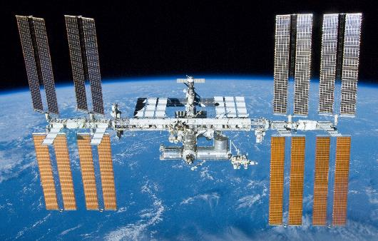
Background
Polymer films are commonly used in the development of membranes
Through my previous research, a membrane that could purify harsh solutions was developed for use in the international space station water recovery system
This project focuses on the mathematical model behind the membrane casting procedure discovered while developing the membrane
http://www.engadget.com/2013/05/10/nasa-reports-ammonia-leak-on-iss/
Notes:
Insert space station picture

Slide 4
Background
Membranes often are created by casting a polymer film on a porous support
During this casting, intrusion of polymer into the pores of the support is a common problem causing
  Uneven film formation
  Lower water flux through membrane
Dilute Polymer Film
Porous Substrate

Slide 5
Background
Membranes often are created by casting a polymer film on a porous support
During this casting, intrusion of polymer into the pores of the support is a common problem causing
  Uneven film formation
  Lower water flux through membrane
Dilute Polymer Film
Polymer intrusion
Porous Substrate

Slide 6
Filler Material Method
Utilizes a liquid filler material to fill the pores of a membrane support and limit intrusion
Leads to formation of a more even surface to cast the actual film
Porous support
Soak in filler material
Cast polymer film

Slide 7
Filler Material Method Model
Balance of capillary, C, and hydrostatic, H, forces
    H₁ +H₂ = C₂ +C₃ – C₁
    Adapted from reference 1
Dilute Polymer Film
H₁ = force of polymer solution
H₂ = force of filler material
C₁ = polymer solution capillary
C₂ = both polymer & filler material
capillary
C₃ = filler material capillary
C₁
H₁
C₂
H₂
C₃
Equally spaced pores filled with filler material
Notes:
Reference

Slide 8
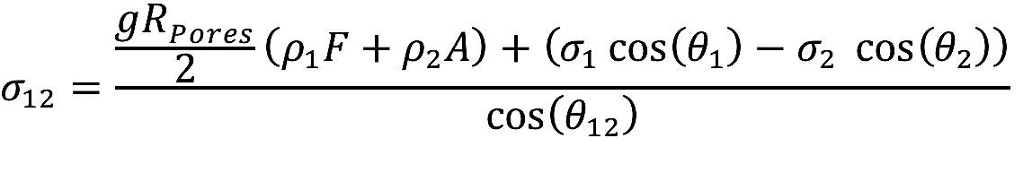
Filler Material Method Model
Final equation arranged for the interfacial surface tension
  Based on:
  Density, ρ
  Film height, F
  Support thickness, A
  Surface tension, σ
  Contact angle, θ
  Subscript 1 denotes polymer solution
  Subscript 2 denotes filler material
F
σ₁₂
A

Slide 9
Filler Material Selection
Select several materials which have a density greater than that of the desired casting solution.
Determine if the selected materials are immiscible with the casting solution.
Measure the interfacial tension between the filler materials and casting solution.
Compare measured interfacial tension, σ₁₂,to the predicted value from the model equation

Slide 10
Filler Material Method Procedure
    Fill the pores of support by soaking support in filler material and allow to dry
    Cast polymer solution on support
    Remove filler material through evaporation or solvent exchange
Porous support
Soak in filler material
Cast polymer film
Remove filler material

Slide 11
Conclusions
The filler material method is a successful way to cast defect-free films and can be used as the basis of new membrane designs.
The method could be used to cast the base layer of a mixed matrix membrane design resulting in an acid resistant membrane that can be used in the international space station
Results of this research will be submitted to be published in the Journal of Membrane Science
Notes:
Insert citation…planned submission

Slide 12
Acknowledgements
NASA/ASU Fellowship Program for funding this project
Dr. Mary Laura Lind for all her support as my research mentor
Pinar Cay for working with me throughout this project

Slide 13
Thank you!
Any questions?

Slide 14
References
P.V.J. Remoortere, Paul, Spontaneous liquid/liquid displacement in a capillary, J Colloid Interf Sci, 160 (1993) 397-404.
M.Z. Peter-Varbanets, Chris; Swartz, Chris; Pronk, Wouter, Decentralized systems for potable water and the potential of membrane technology, Water Research, 43 (2009) 245-265.
R.F.T. Madsen, J.R.; Vial, D.; Binot, R.A., The proposal for the completely closed system in the columbus space station, Desalination, 83 (1991) 123-136.
E.M.v.Z. Voorthuizen, Arie; Wessling, Matthias, Nutrient removal by NF and RO membranes in a decentralized sanitation system, Water Research, 39 (2005) 3657-3667.
M.P. Maurer, W.; Larsen, T.A., Treatment processes for source-separated urine, Water Research, 40 (2006) 3151-3166.

Slide 15
Details of Derivation
Began with a model developed by Remoortere and Joos for liquid-liquid displacement in glass capillaries¹
The filler material is only present in the pores and not on the support surface.
The polymer solution is only present on the support surface and not in the pores.
  l₁ = A = support thickness= height of filler material in capillary [m]
  l₂ = height of the column of polymer solution within the capillary = 0
  L₁ = height of filler material outside of the capillary [m] = 0
  L₂ = F = known film thickness of polymer solution [m]
Notes:
l = height of the column of each liquid within the capillary [m]
L = height of each liquid outside of the capillary [m]
θ^{º} = static advancing contact angle [radians]
σ = surface tension [N m⁻¹]
σ₁₂ = interfacial tension between the displacing fluid and the displaced fluid [N m⁻¹]
Subscript 1= displacing liquid = filler material
Subscript 2 = displaced liquid = polymer solution

